Slide 1
Network

Slide 2
NETWORKING
Exchange of information from one to another device ie) sender to receiver
A network is basically all the components involved in connecting computer and application across small and large distances.
Communicating or sharing the data from sender to receiver.
Networking is mainly used for purpose, they are communication and sharing.
Notes:
ARPANET ?
Basis of Internet
1st published in 1967
It was early packet switching Network
1st network to implement the protocol suite TCP/IP
Founded by ARPA(Advanced Research Project Agency)

Slide 3
CHARACTERISTICS
Cost
Security
Speed
Topology
Scalability
Reliability
Availability

Slide 4
BASICS
Medium
NIC
Addressing
Types of network
Types of topology
Basic hardware

Slide 5
MEDIUM
There are two medium involved in the networking, they are
1)Wired 2) Wireless
Wired- it using electric & light transmit cables
Wireless- it using electromagnetic waves

Slide 6
TYPES OF NETWORK
LAN
MAN
WAN
CAN
SAN
WLAN

Slide 7
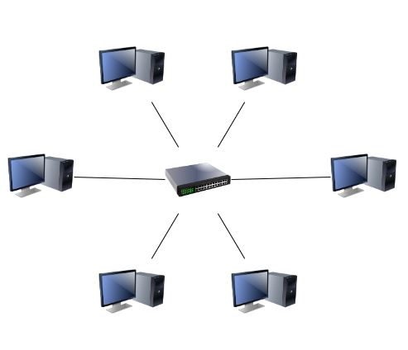
LAN(Local Area Network)
Notes:
It is a data communication system within a building plant or campus, between near by buildings.
LAN connect network device shortly distance
LAN is also called intranet.

Slide 8
MAN (Metropolitan Area Network)
LAN
LAN
MAN
LAN
LAN
LAN
Notes:
Collection of many LAN
Physical area larger than a LAN but smaller than WAN such as city.
A MAN is typically owned and operated by a single entity such as government body large corporation

Slide 9
WAN (Wide Area Network)
MAN
LAN
LAN
LAN
MAN
WAN
MAN
LAN
MAN
LAN

Slide 10
CAN (Campus Area Network)
A Network spanning multiple LAN’s bus smaller than a MAN such as a university or local business campus.
It connects server to data storage device through a technology like fiber channel.
It link high performance computer with high speed connection
SAN (Storage Area Network)

Slide 11
TOPOLOGY
Two or more devices connected to a link, two or more link form a topology.
Topology is a protocol.
Types
Bus
Ring
Star
Extended star
Mesh
Tree
Hybrid
Notes:
It is used to know how to connect a system
Direct physical connection of a system.

Slide 12
Bus TOPOLOGY
s/m 1
s/m 3
Cable end
Cable end
tap
tap
tap
s/m 2
Notes:
The bus topology is also called linear topology in which one wire connects all the nodes and the terminator and wire.
Every system connected to a single cable.
Its every connection will be look like a “T” connector.
Terminator should be used in every end of the cable in two sides.

Slide 13
Ring TOPOLOGY
node2
Token ring
node1
node3
node4
Notes:
The nodes are connected in the form of circle
Point to point line configuration only with the two devices on either side of it.
A signal is passed along the ring in one direction from device to device until it reaches its destination.
When a device receives a signal intended for another device, its repeater regenerates the bit and passes them along

Slide 14
Star TOPOLOGY
Centralized system
Hub, switch
or router
Notes:
In a star network each node is connected to a central device called a hub or switch.
The devices are not directly linked to each other.
Data passes through the router, hub or switch before continuing to its destination.
The router, hub or switches manage and control all functions of the network.

Slide 15
EXTENDED STAR TOPOLOGY
Two or more star topology connection .
router

Slide 16
Mesh TOPOLOGY
Notes:
Each node is connected to every other node is the mesh network
Each node may send message to destination through multiple path

Slide 17
HYBRID TOPOLOGY
Combination of two or more topology
ring
star
bus

Slide 18
TRANSMISSION
There are three types of connection. They are
Unicast – one to one
Multicast – one to many
Broadcast – one to all
Notes:
Ex:
Unicast -> Downloading a file from a FTP Server. (FTP Server is the sender and your computer is the receiver.)
Multicast -> walkie talkie, whatsapp(broadcast msg)
Broadcast - > TV, Radio

Slide 19
COMMUNICATION
There are three types of communication, they are
Simplex - receive the information only
Eg: cable TV
Half duplex – send & receive the information one after one
Eg: walkie talkie
Full Duplex – send & receive information simultaneously
Eg: mobile phone

Slide 20
BASIC HARDWARE
NIC
Hub
Bridge
Switch
Repeater
Router
Access point

Slide 21
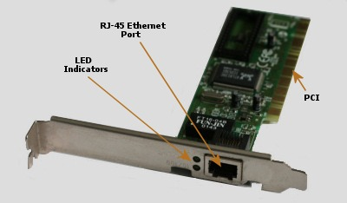
NIC
It is one of the networking device.
It is responsible for sending and receiving data on the network
In NIC it contains address in the form of 12 characters
eg: 00-EA-F6-77-D0-11
Notes:
Network interfacing card
There are two types of address, they are
MAC address (Media Access Control)
IP address (Internet Protocol)

Slide 22
MAC Address
Each NIC card has a unique address
Unique address is a MAC address
Ex: 0B-B3-8E-22-3C-E2
It is a 48 bit address
Hexadecimal format 12 characters
e.g. IMEI number
Notes:
48 -> binary digits
00-02-3F - First half will be manufacturer ‘s address
6B-25-13 - Second half will be unique ID assigned to the network card

Slide 23
IP Address
IP address is a number used to indicate the location of a computer or other device on a network using TCP/IP.
Types of IP Address
IPv4
IPv6
Notes:
IETF? ->Internet Engineer Task Force
IPv4 -> 32 bit binary address
IPv6 ->128 bit binary address

Slide 24
CLASSES OF IP ADDRESS
Five classes
class A
class B
class C
class D
class E

Slide 25
X.X.X.X
Network ID
A B C
00000000.00000000.00000000.00000000
0NNNNNNN - 0NNNNNNN -> A
10NNNNNN - 10NNNNNN -> B
110NNNNN – 110NNNNN -> C
1110NNNN – 1110NNNN -> D
1111NNNN – 1111NNNN -> E
0 0 0 0 0 0 0 0
2⁷ 2⁶ 2⁵ 2⁴ 2³ 2² 2¹ 2⁰
128+64+32+16+8+4+2+1 = 255
Notes:
N->Network
Remain -> hosts

Slide 26
Class A
IP:- 0.0.0.0 to 127.255.255.255
SNM:- 255.0.0.0
Class B
IP:- 128.0.0.0 to 191.255.255.255
SNM:- 255.255.0.0
Class C
IP:- 192.0.0.0 to 223.255.255.255
SNM:- 255.255.255.0
Notes:
A
used for very large networks and always start with a leftmost bit being a zero
Ex: Apple, IBM, HCL
B
medium sized networks
Ex: flip kart
C
smaller networks
Ex: small companies

Slide 27
Class D
IP:- 224.0.0.0 to 239.255.255.255
It is a multicast address.
Class E
IP:- 240.0.0.0 to 255.255.255.255
It is used only for scientific purpose

Slide 28
PRIVATE IP RANGE
10.0.0.0 to 10.255.255.255 – (1,67,77,216 No. of add)
172.16.0.0 to 172.31.255.255 – (10,48,576 No. of add)
192.168.0.0 to 192.168.255.255 – (65,536 No. of add)
Notes:
D & E -> It does not have any network id and host id

Slide 29

IPv6
It is the latest version of IP
It uses 128-bit address
It consists of 8 groups of 4 hexadecimal digits separted by colon(:)
Global Prefix subnet Interface ID
XXXX : XXXX : XXXX : XXXX : XXXX : XXXX : XXXX : XXXX

Slide 30
HUB
It is a networking device that is used to connect two or more than two computers within a network.
Hubs are also called as a multiport repeater and it does not know any type of IP address(MAC & IP).
Notes:
Its only knows the source port so it broadcast the data to all port except the source port.
It divides the bandwidth among the user
Hub always makes a broadcast and as a result of broadcast bandwidth will get wasted.

Slide 31
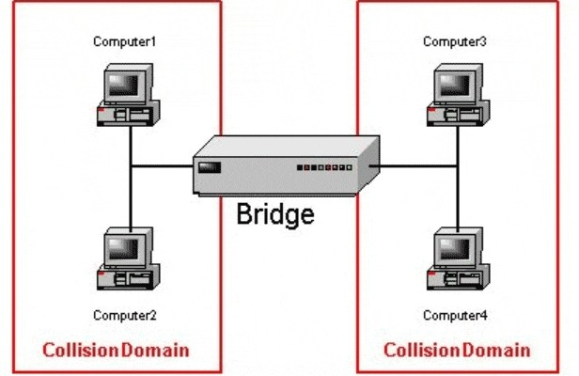
BRIDGE
A bridge is a layer 2 device that provides communication between two or more segments.
Notes:
Work station on one segment are able to communicate with those on another segment through a bridge.
Like a repeater a bridge extends the maximum distance of the network

Slide 32
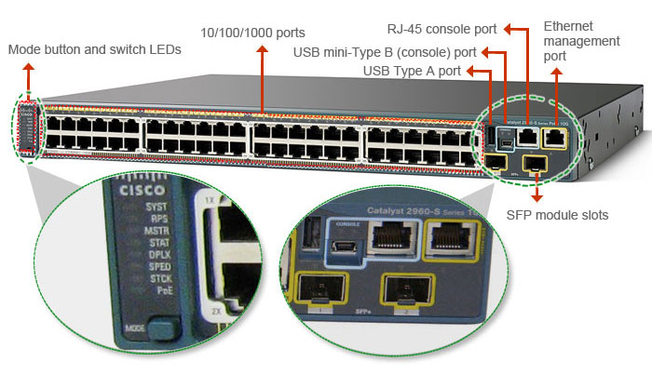
SWITCH
It is a networking device that is used to connect two or more computers within a LAN

Slide 33
The switch will collect all the MAC address which are all connect to it.
Then it will create a MAC table.
It will identify the destination by doing broadcasting.
It will create a virtual path between source and destination.
If the second data wants to be transfer, it will check the MAC address which is already stored in the Mac table
Due to this there will be a limited broadcasting.

Slide 34
REPEATER
Repeater is a device which is used to strengthen the electrical signal.
If the two system is placed at far distance, the signal will become so weak by the time it reaches the other side is unreadable.
Hub is a multiport repeater.
Repeater will suppress the noise.

Slide 35
ACCESS POINT
Wireless access points are network devices that can be connected to a wired network to allow a wireless client to pass through to get access to the wired network and its resources.

Slide 36
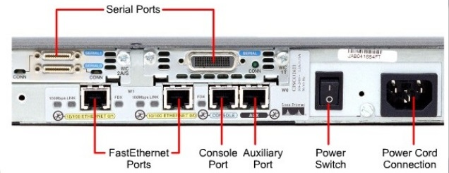
ROUTER
It is a network device which is used to connect the different networks.
It fully depends upon the IP address not an MAC address
Notes:
There is no broadcasting.
No collision

Slide 37
GUIDED MEDIA
There are three types of guided media
Co-axial cable
Fiber optics wire
Twisted pair wire

Slide 38
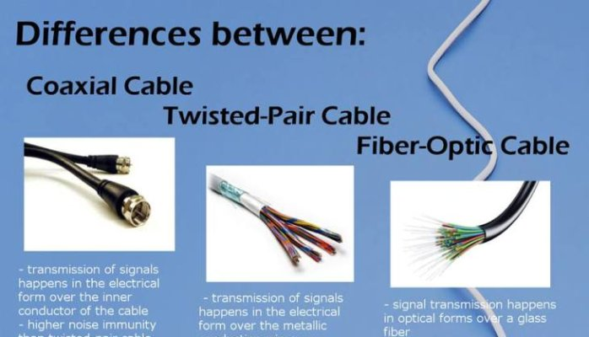
Notes:
Co-axial Wire
It is a kind of copper cable.
This wire is used by the cable operator.
Advantage
High data transfer rate
Cheaper
More protection from external interface
Disadvantage
Easy to hack.
Regular number of repeater and amplifier are used.
Twisted pair cable
It is type of copper cable that has extensively used for telephone system and data networks.
There are two types
UTP (unshielded twisted pair)
STP (shielded twisted pair)
Fiber optical cable
A optical fiber is a flexible transparent fiber made of glass or plastic ticker than a human hair.
Advantage
High data transmission rate because the data is transferred with the speed of the light
Widely coverage 1.5km to 2km
More secure and reliable
Speed upto 100Gbps
DisAdvantage
Fiber optics is costly.
Lot of legal formalities to install the wire.
Difficult to trouble shoot.

Slide 39
UTP Categories
Category | Type | Speed
Cat 1 | 1 pair | less than 10 mbps
Cat 3 | 3 pair | 10 mbps
Cat 4 | Ethernet cable | 100 mbps
Cat 5 | Fast Ethernet cable | 10-100 mbps
Cat 5e | fast Ethernet cable | 1000 mbps
Cat 6 | Gigabyte Ethernet | Above 1000 mbps

Slide 40
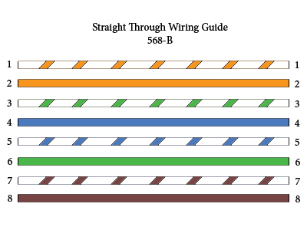
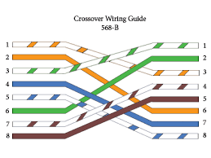
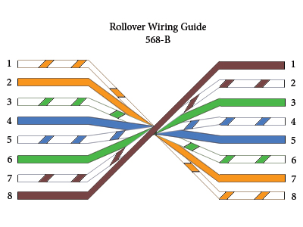
Types of cable in LAN
Notes:
Straight through cable
Connect to any device
pc to router
Pc to pc
Pc to switch
Cross over cable
Connect only same device
pc to pc
Hub to hub
Switch to switch
Roll over cable
Only pc to router

Slide 41
4 PAIRS
Pin no | Colors | FUNCTION
1 | Orange | Data sending purpose
2 | White/orange | Data sending purpose
3 | Blue | Support for data sending
4 | White/blue | Not working
5 | Green | Nor working
6 | White/green | Data receiving purpose
7 | Brown | Data receiving purpose
8 | White/brown | Support for receiving purpose
Notes:
It default color of the wire
4 & 5 inactive
1,2 -> used the send the data
3-> additional port for data sending
6,7 -> used to receive the data
8-> additional port for data receiving

Slide 42
ROUTER
Cisco routers and switches has four types of memory
ROM
Flash
NVRAM
RAM

Slide 43
FLASH
It is similar to hard disk of our computer (EEPROM).
It contains the copy of IOS.
RAM
Running configuration
It is volatile memory
It will access the data which we give.
Eg: if any sudden power failure all the change made but not save.

Slide 44
NVRAM
Startup configuration
Non volatile random access memory
In case of which all changes made and saved will not yet lost.
ROM
POST(Power on self test) – It is used for hardware testing.
Bootstrap – Its specify the router from where to load the os.
Mini IOS – Minimum set of driver that is required to boot the router.

Slide 45
PARTS OF A ROUTER
There are two different types of ports. they are
Interfaces
Lines

Slide 46
INTERFACE
It connects router and switches to each other.
Serial interface
Token ring interface
Ethernet
Fast Ethernet
Asynchronous transfer mode(ATM)

Slide 47
LINES
Lines are used to get the access a router in order to configure the router.
Console ports
Auxiliary ports
VTY (telnet) ports

Slide 48
MODES OF ROUTER
Execution mode
Privileged mode
Global configuration mode
Interface mode

Slide 49
Execution Mode
The symbol “>” indicates execution mode.
Router>
No configuration can be viewed from user mode. Only basic status information can be viewed from this mode.
Router > enable------- go to privileged mode.

Slide 50
Privileged Mode
The symbol “#” indicates privileged mode
It allows access to all router commands including router configuration, settings, status information and management command.
This level is usually password protected for security reason.
Router > enable
Router #
To return back to user mode
Router # disable

Slide 51
Global Configuration Mode
Global configuration mode provides command to change the system configuration.
Router # configure terminal
Router (config)#
To return back to privileged mode
Router (config)# exit
Router#

Slide 52
Interface Mode
Interface mode is used to assign the IP address, Subnet mask
Router(config)# interface(connection type)
Router(config-if)# ip add <ip addr><SNM>
Router(config-if)# no shutdown
Router(config-if)# full-duplex / half-duplex
Router(config-if)# exit

Slide 53
SSH Configuration
Router(config)# hostname R1
Router(config)#ip domain-name router.in
Router(config)#line vty 0 4
Router(config-line)#transport input ssh
Router(config-line)#login local
Router(config)#crypto key generate rsa
Router(config)#username user password mypwd1
Router(config)#enable secret mypwd2
Router(config)#service password-encryption
Router(config)#ip ssh timeout 120
Router(config)#ip ssh authentication-retries 3
Router(config)#ip ssh version 2
Router#show ip ssh
Notes:
Ssh -> secure shell

Slide 54
Routing
Process of moving the packets from one network to another network using routers
Routing protocol determine the path of a packet through internetwork.
Routing Protocols are
Static
Default
Dynamic

Slide 55
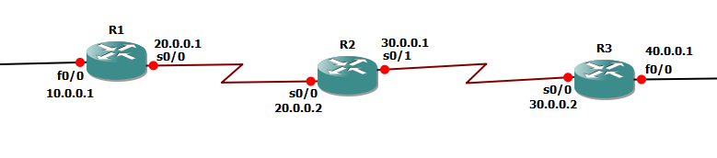
For Static
Router(config)#ip route <destination n/w> <subnetmask> <next hop address>
eg: R1(config)#ip route 10.0.0.0 255.0.0.0 20.0.0.2
For Default
Router(config)#ip route <any ip> <any subnetmask> <net hop address>
eg: R1(config)#ip route 0.0.0.0 0.0.0.0 20.0.0.2
Notes:
For Static
R2(config)#ip route 20.0.0.0 255.0.0.0 30.0.0.1
R2(config)#ip route 20.0.0.0 255.0.0.0 10.0.0.1
R3(config)#ip route 30.0.0.0 255.0.0.0 40.0.0.1
R3(config)#ip route 30.0.0.0 255.0.0.0 20.0.0.2
For Dynamic
R2(config)#ip route 0.0.0.0 0.0.0.0 30.0.0.1
R2(config)#ip route 0.0.0.0 0.0.0.0 10.0.0.1
R3(config)#ip route 0.0.0.0 0.0.0.0 40.0.0.1
R3(config)#ip route 0.0.0.0 0.0.0.0 20.0.0.2

Slide 56
Dynamic Protocols
2 types
IGP
RIP
OSPF
EIGRP
BGP
IBGP
EBGP
Notes:
IGP -> Internal Gateway Protocol
BGP -> Border Gateway Protocol
RIP -> Routing Information Protocol
EIGRP -> Enhanced Interior Gateway Routing Protocol
OSPF -> Open Shortest path First
IBGP -> Internal BGP
EBGP -> External BGP

Slide 57
RIP
RIP is sends the complete routing table out to all active interfaces every 30 seconds
It has a maximum allowable hop count of 15 by default.
Configuration
R1(config)#router rip
R1(config-router)#network 10.0.0.0
R1(config-router)#network 20.0.0.0
R2(config)#router rip
R2(config-router)#network 20.0.0.0
R2(config-router)#network 30.0.0.0
R3(config)#router rip
R3(config-router)#network 20.0.0.0
R3(config-router)#network 30.0.0.0
Notes:
If 16 host hop is unreachable

Slide 58
EIGRP
It uses Diffusing Update Algorithm(DUAL) to determine the best path among the feasible paths
Both calculate metrics using bandwidth and delay
Use autonomous system numbers
It has a maximum allowable hop count of 224 by default.
It Supports CIDR
EIGRP uses the transport-layer protocol to guarantee delivery of routing information

Slide 59
EIGRP Configuration
Router(config)#router eigrp autonomous-system-number
Router(config-router)#network network-id
router(config-router)#no auto-summary
Ex:
Router(config)#router eigrp 101
Router(config-router)# network 10.0.0.0
router(config-router)#no auto-summary
Notes:
Autonomous system number indicates all routers belonging to the Internetwork.
Should be configured on Serial links so that convergence happens quickly. Mismatched bandwidth will cause network problem

Slide 60
OSPF
OSPF is a routing protocol for Internet Protocol (IP) networks. It uses a link state routing (LSR) algorithm and falls into the group of interior gateway protocols (IGPs), operating within a single autonomous system (AS)
Configuration:
Router(config)# router ospf process_id
Router(config-router)#network <network_id> <wildcard mask> area <area_number>
Router(config-if)#ip ospf hello-interval 15
Router(config-if)#ip ospf dead-interval 60
Eg: R1(config)# router ospf 10
R1(config-router)#network 10.0.0.0 0.255.255.255 area 0
R1(config-router)#network 20.0.0.0 0.255.255.255 area 0
Notes:
Open Shortest Path First (OSPF)
Eg: R1(config)# router ospf 10
R1(config-router)#network 10.0.0.0 0.255.255.255 area 0
R1(config-router)#network 20.0.0.0 0.255.255.255 area 0
Interface mode
Hello-interval
Dead-interval

Slide 61
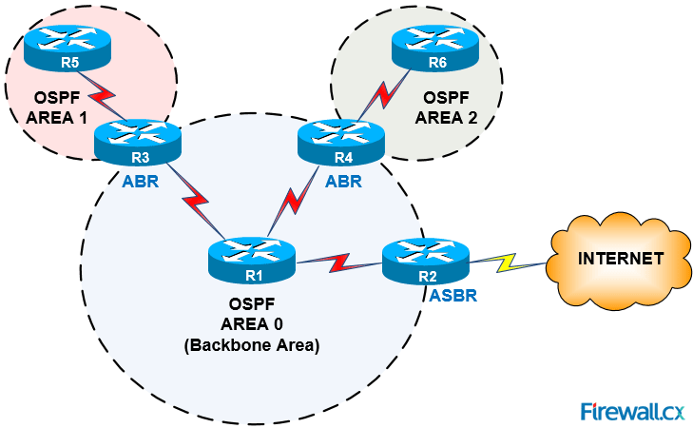

Slide 62
BGP
BGP is protocol that manages how packets are routed across the internet through the exchange of routing and reachability information between edge routers
BGP uses TCP to connect peers
Advantages:
No need for periodic refresh - routes are valid until withdrawn, or the connection is lost
Incremental updates
Disadvantages
Congestion control on a routing protocol?
Poor interaction during high load
Notes:
Border Gateway Protocol (BGP)

Slide 63
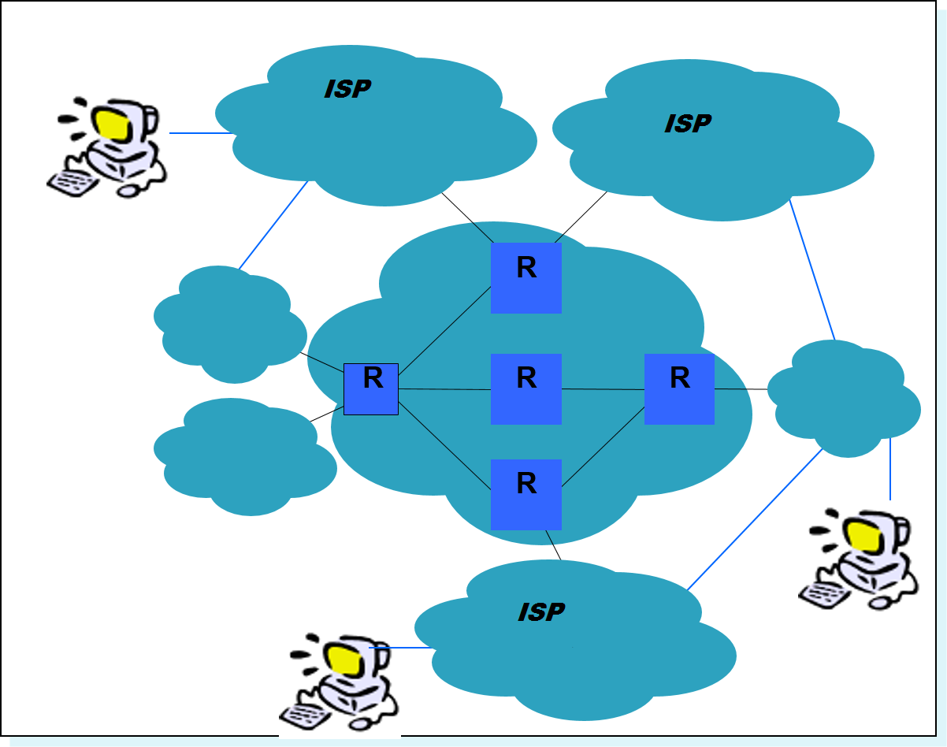

Slide 64
BGP Configuration
Router(config)# feature bgp / no feature bgp
Router (config)# router bgp 20
Router(config-router)# neighbor 10.0.0.1
Router(config-router)# address-family <ipv4/ipv6> <unicast/multicast>

Slide 65
Verify Configuration
Show ip int brief
Show ip int stats
Show ip int f0/0 stats
Show ip route
Show ip protocols
Show IP EIGRP neighbor
Show IP EIGRP Interfaces
Show IP EIGRP Topology
Show Ip ospf neighbor
Show ip ospf interfaces
Show bgp all
Show bgp 20

